Slide 1
Cross Platform Assignment 2
Screenshots and Output Videos
Name : Pratiksha Jadkar
Roll No .: 2022mt93717
EmailId : 2022mt93717@wilp.bits-pilani.ac.in

Slide 2
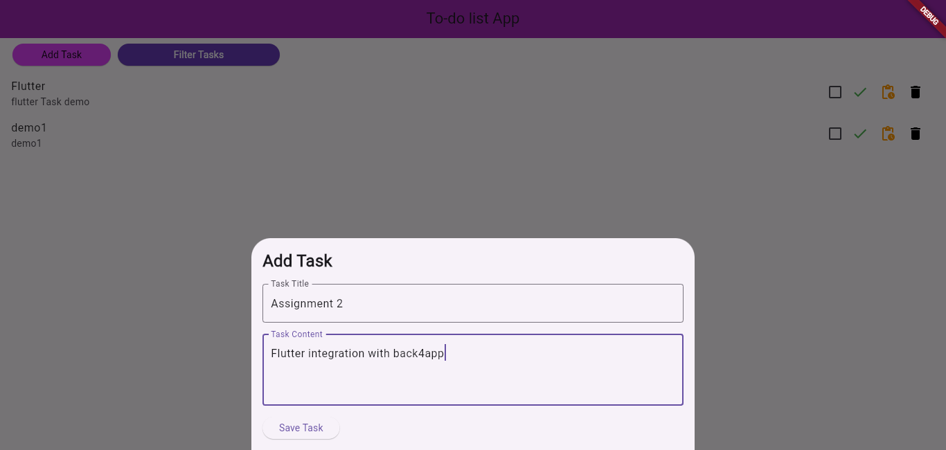
Chrome output
Add new task

Slide 3
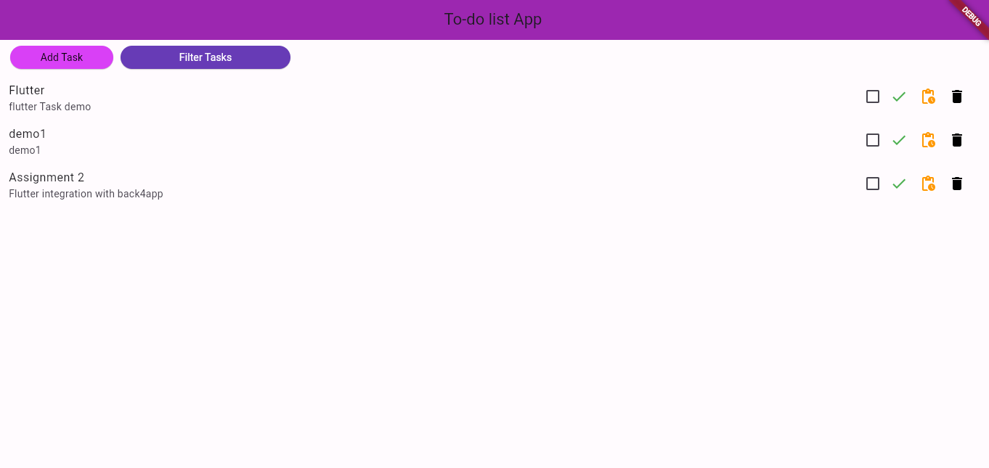
Chrome output
Task list

Slide 4
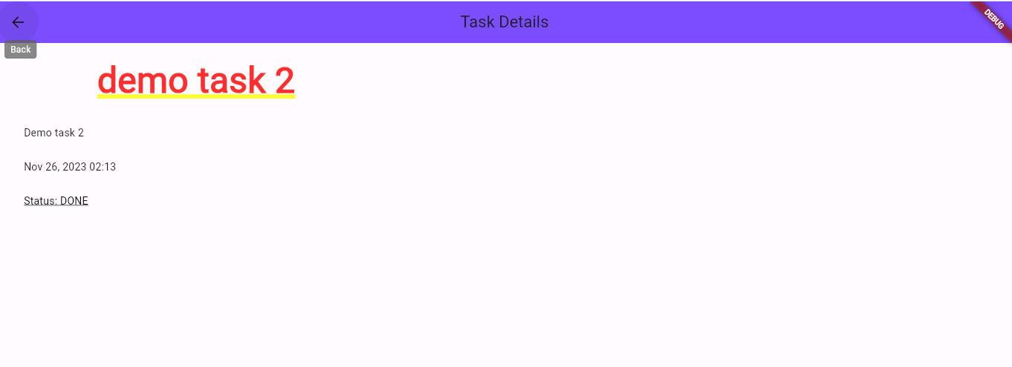
Task status

Slide 5
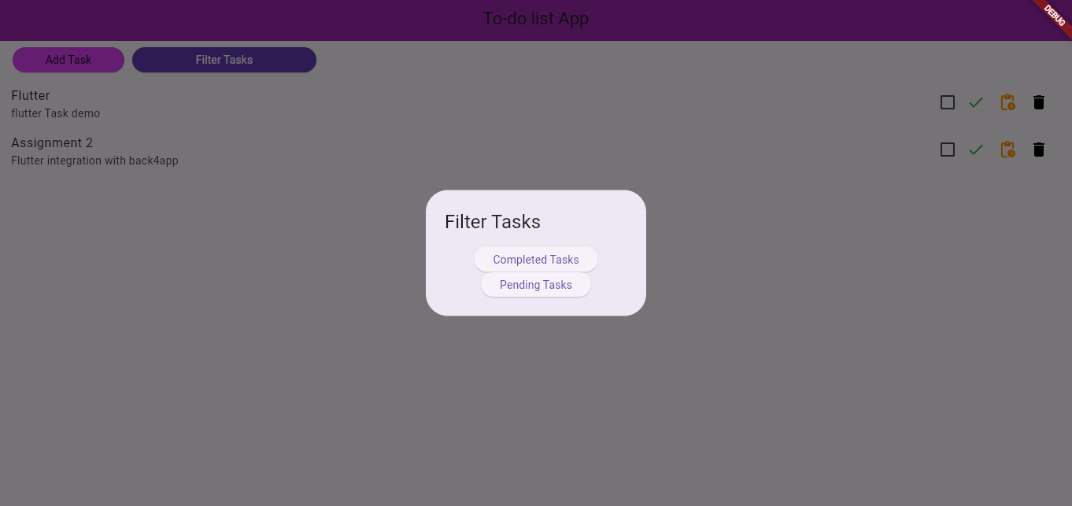
Chrome output
Filter tasks according to Status of tasks

Slide 6
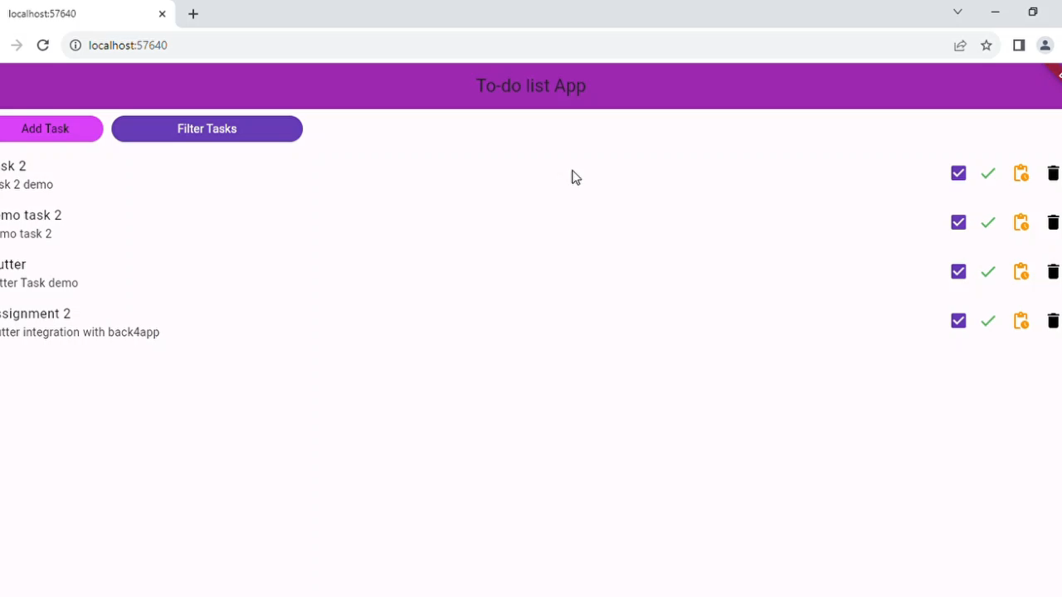
Output Video
Chrome Output_CLICK HERE

Slide 7
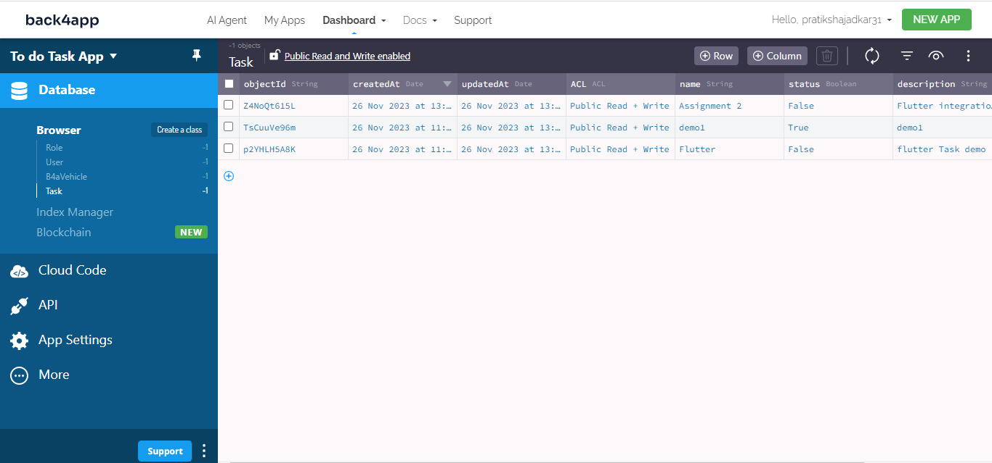
Back4App
Class : Task

Slide 8
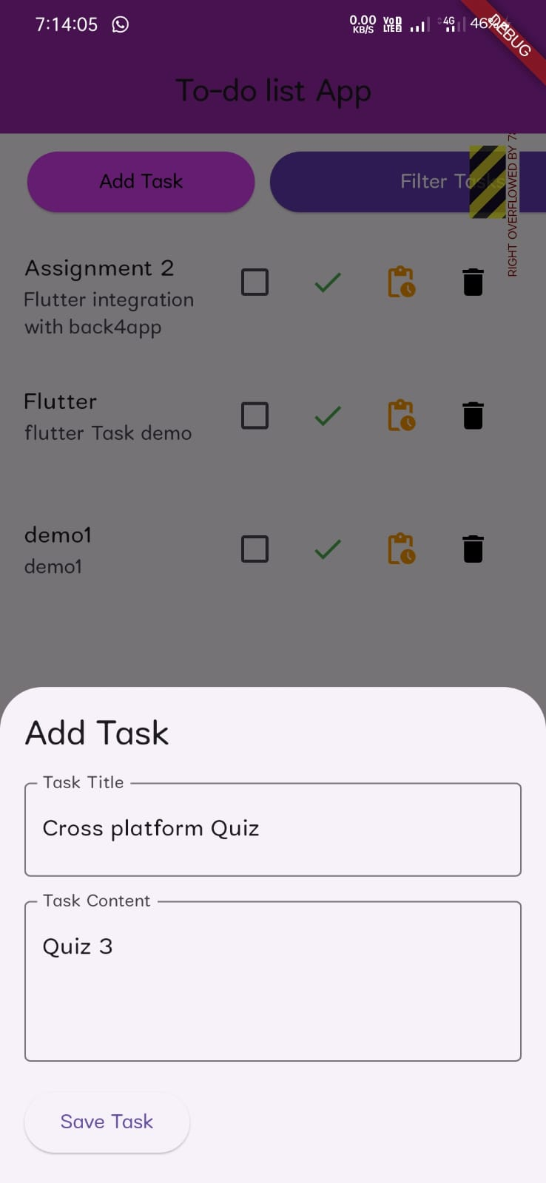
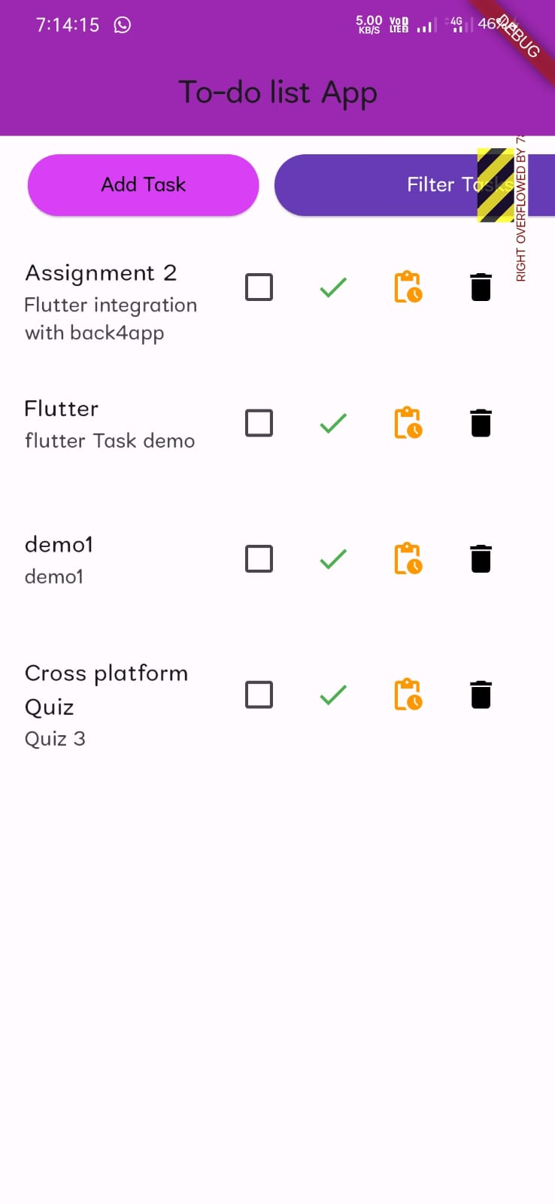
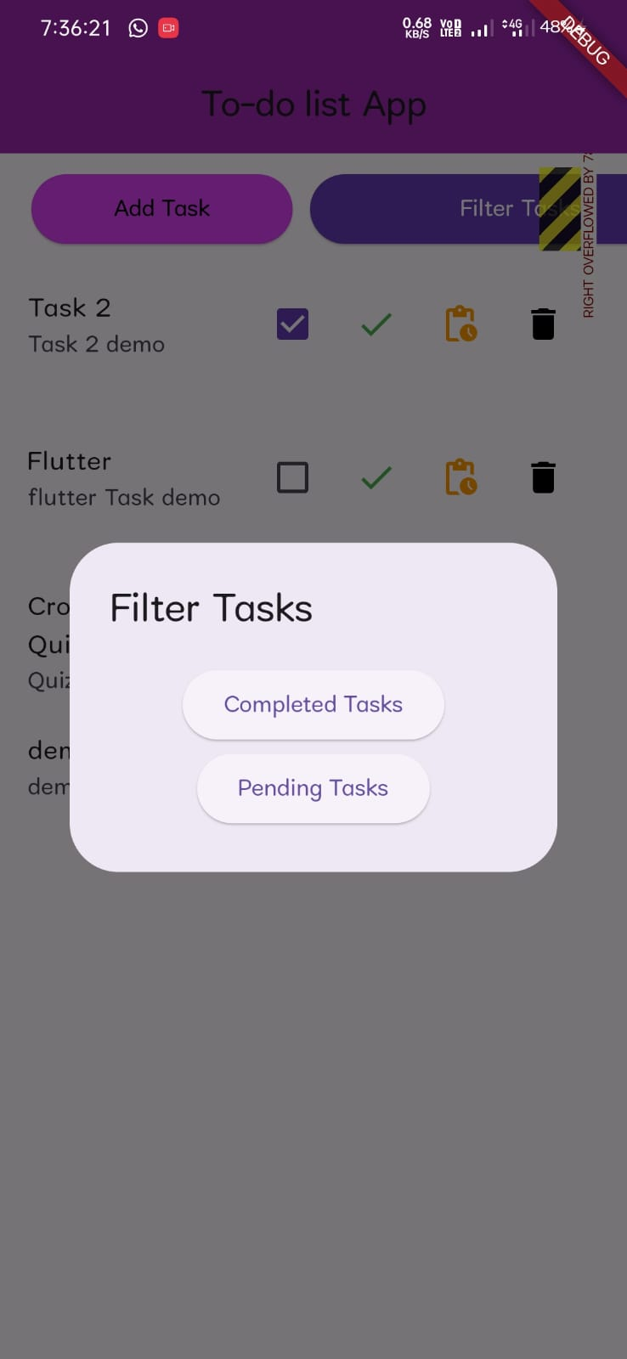
Android Output Images

Slide 9
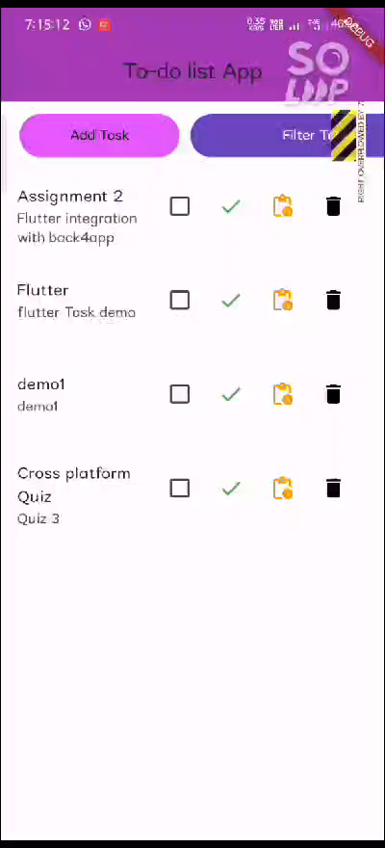
Android Output
Android Output Video Link_ CLICK HERE

Slide 10
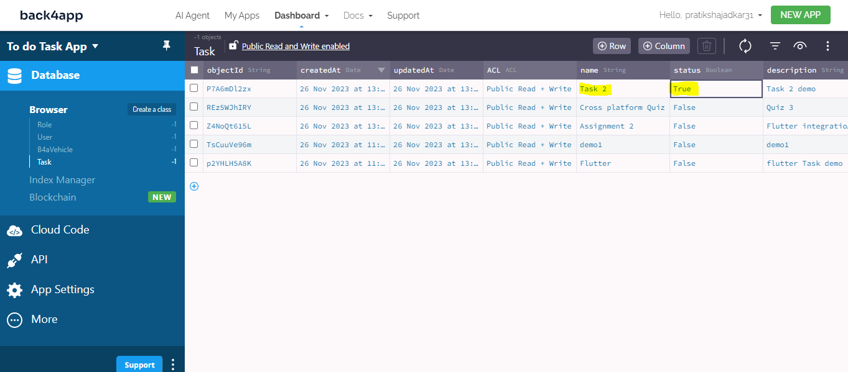
Back4App
Class : Task

